Slide 1
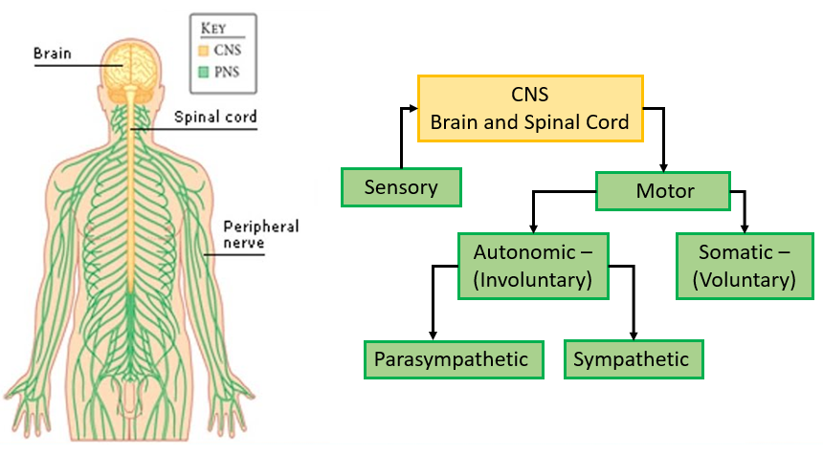
Divisions of the Nervous System: Peripheral Nervous System (PNS) – Motor Reflexes
Ch4 HP: The nervous system is highly organised

Slide 2
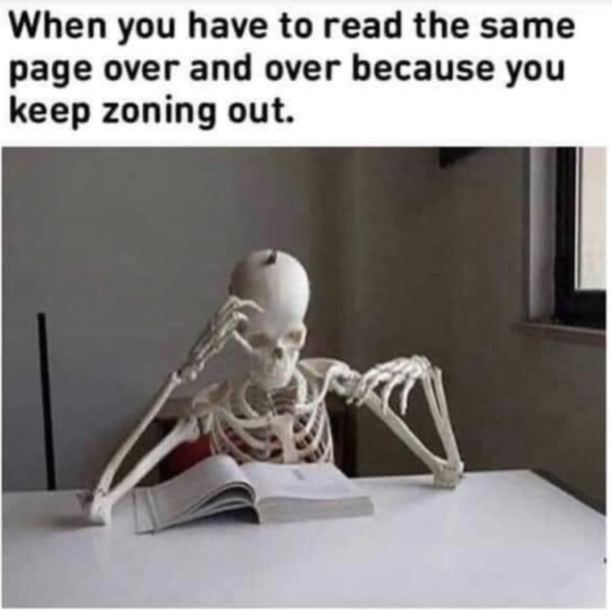
Date: | Human Biology Year 12 ATAR
Do Now Complete the past exam question given, under test conditions (not for actual marks) Lesson Agenda 1: Do Now 2: Peripheral NS overview and PNS- Sensory 3: Work on Review Worksheet: PNS overview and sensory 4: Lesson summary and wind-up Suggested Study Compulsory: Complete review worksheet, mark and correct using answer key on Connect. Read through today’s notes and textbook section Write out the steps involved in transmission across the synapse. NEXT LESSON Past Exam Question PNS- Motor, Reflex Arcs | Learning Aims List the parts and functions of the motor division of the PNS Describe the structure and function of somatic motor neurons Describe the function of the autonomic division of the motor PNS Compare and contrast the Sympathetic and Parasympathetic neuron pathways of the autonomic motor PNS Describe the broad structure and functions of the sympathetic and parasympathetic parts of the autonomic division of the motor PNS. Describe the synapses and neurotransmitters involved the neuron pathways of the motor PNS. Define reflexes and list the 4 properties of reflexes Describe the components of a reflex arc Explain differences between innate and acquired reflexes List some common reflexes
 | Key Vocabulary Peripheral Nervous System (PNS) Central Nervous System (CNS) Somatic Autonomic Ventral Ganglion Sympathetic Parasympathetic

Slide 3
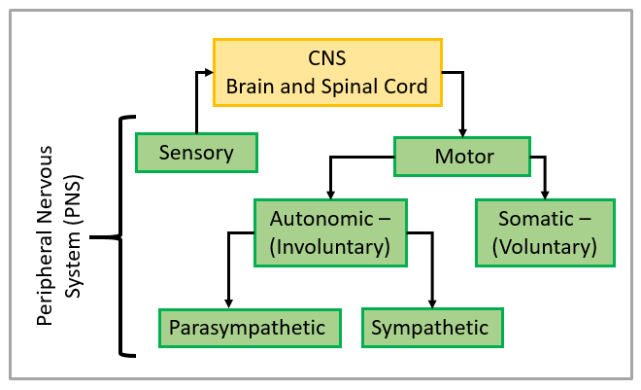
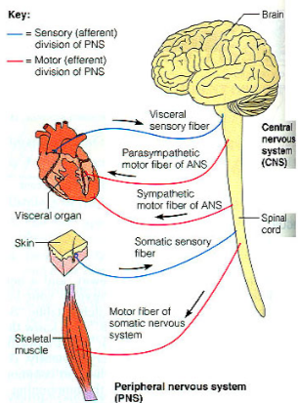
Efferent (motor) Division
Takes signals from CNS to body organs and systems to respond
Somatic:
CNS to skeletal muscles
Contraction, muscle tone and movement
Some voluntary control
Autonomic:
CNS to smooth muscle in body organs, and glands
Involuntary – not under conscious control
2 divisions:
Sympathetic
Parasympathetic
Learning Aim: List the parts and functions of the motor division of the PNS

Slide 4
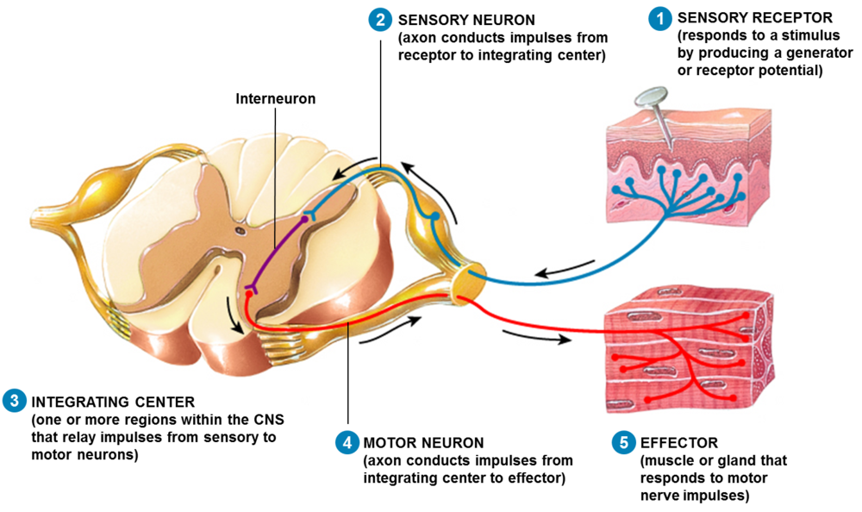

Slide 5
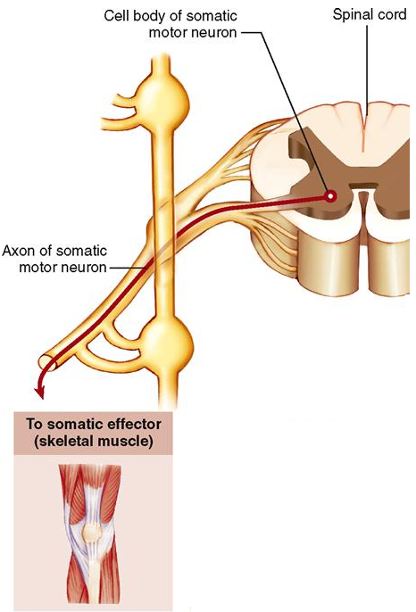
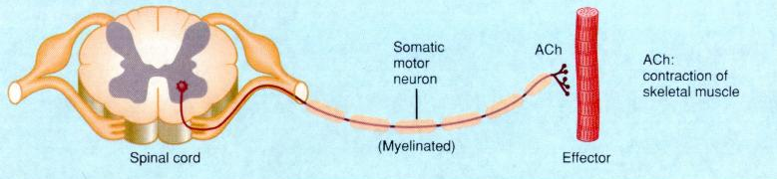
Somatic Division of Motor PNS
CNS to skeletal muscles
Acetylcholine (ACh) release stimulates muscle contraction
Under mostly conscious control
Cell bodies are in CNS (eg spinal cord)
Axons extend from CNS all the way to muscles
No intermediate synapses or ganglia
Learning Aim: Describe the pathway, structure and function of somatic motor neurons

Slide 6
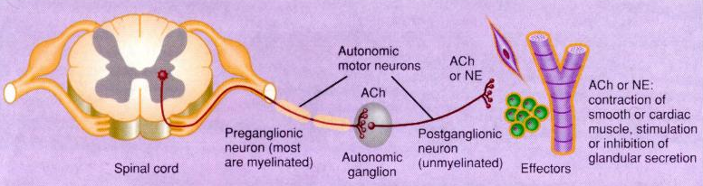
Autonomic Division of Motor PNS
Signals from CNS to smooth muscle inside body organs
Mostly involuntary
Two divisions: Sympathetic and Parasympathetic
Involved in adjustment of internal environment: homeostasis
Motor neuron from CNS to autonomic ganglion, then another to effector tissue.
Learning Aim: Describe the pathway, structure and function of autonomic motor neurons

Slide 7
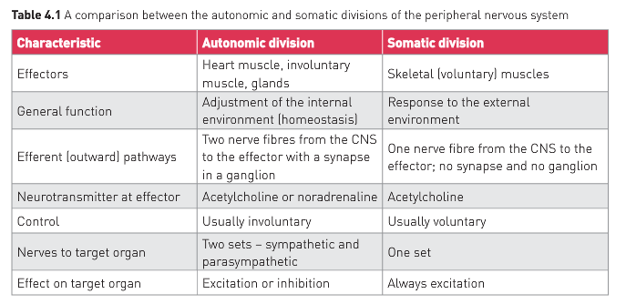

Slide 8
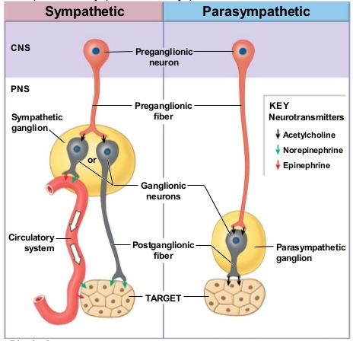
Autonomic Division of Motor PNS
Sympathetic:
“fight or flight”
Norepinephrine (noradrenaline) released at tissues
Ganglia closer to CNS
Parasympathetic
“rest and digest”
Acetylcholine (ACh) released at tissues
Ganglia further from CNS
Learning Aim: Compare and contrast the pathway, structure and function of sympathetic and parasympathetic autonomic motor neurons

Slide 9
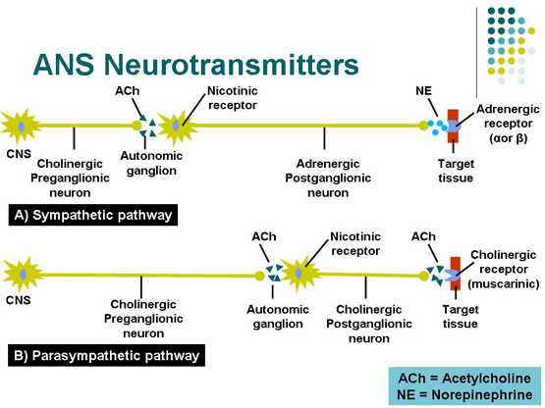
Learning Aim: Describe the pathway, structure and function of somatic motor neurons

Slide 10
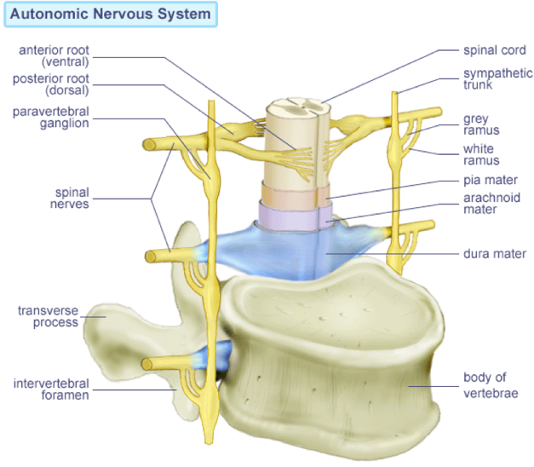
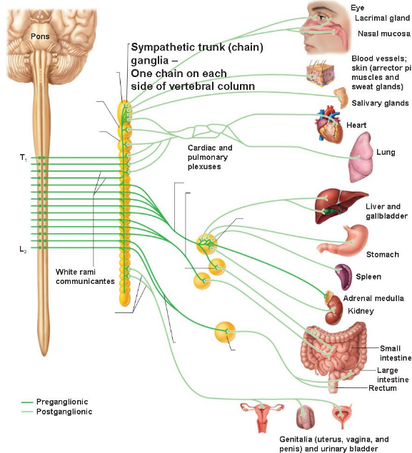
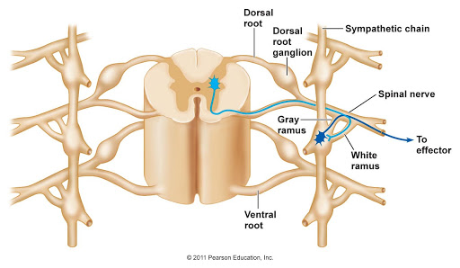
Organisation of the Sympathetic NS
Learning Aim: Describe the broad structure of the sympathetic NS

Slide 11
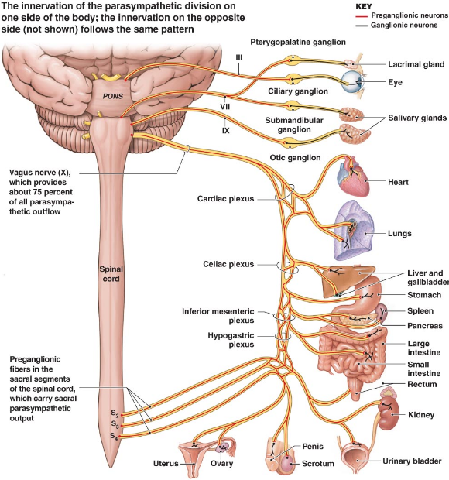
Organisation of the Parasympathetic NS
Parasympathetic Neurons emerge from the brain and from the base of the spinal cord, not from the ventral roots of most segments of the spinal cord.
(Sympathetic and motor fibers emerge from the ventral roots of most spinal segments.)
Learning Aim: Describe the broad structure of the parasympathetic NS

Slide 12
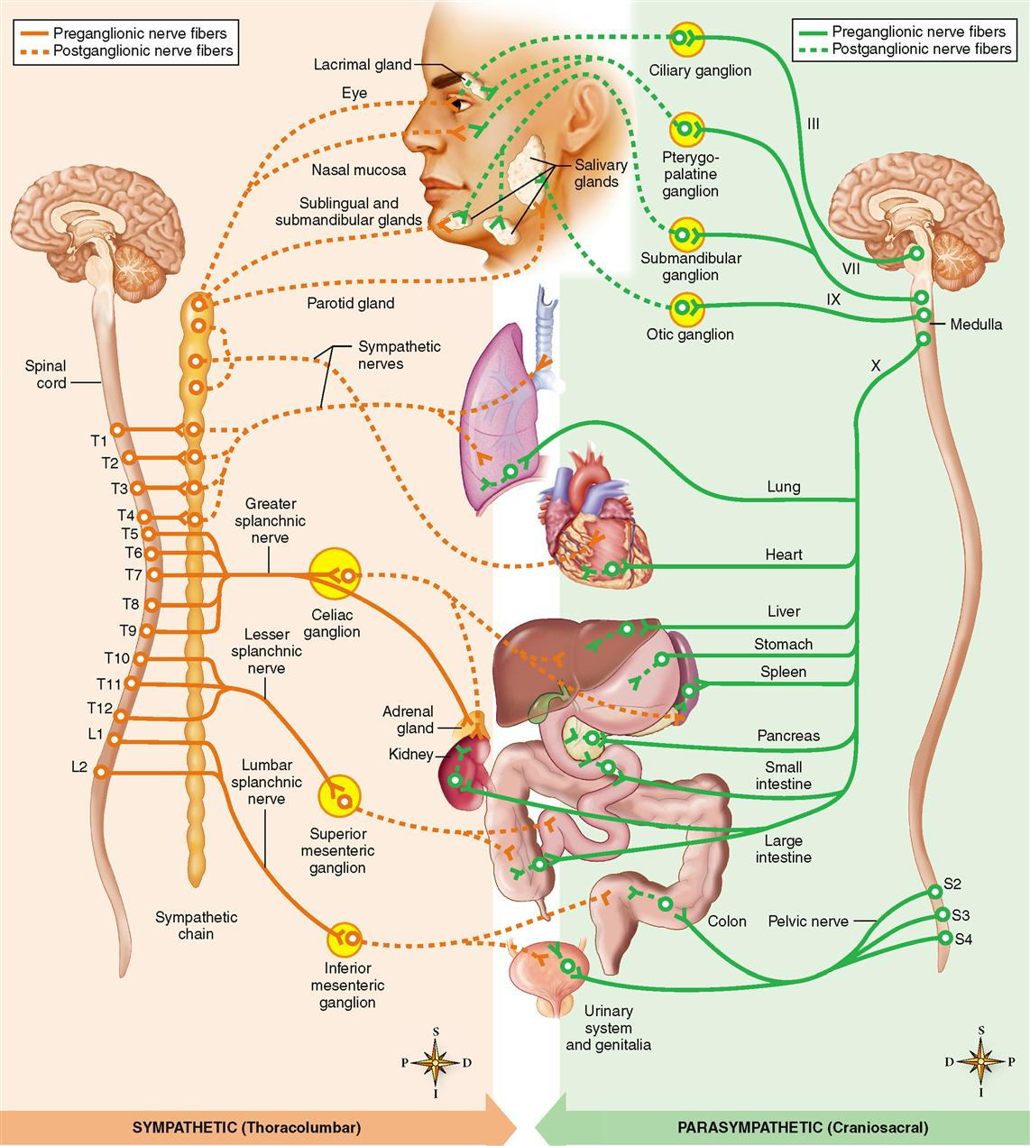
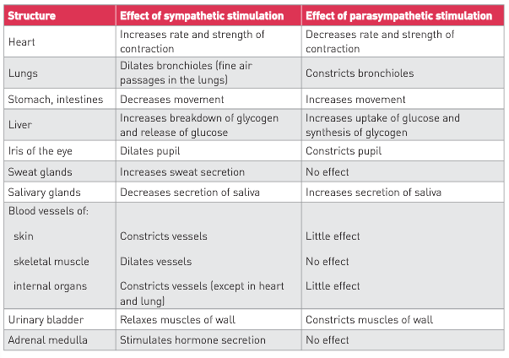
Visceral Organs and Blood vessels are stimulated by both Sympathetic and Parasympathetic neurons.

Slide 13
Sympathetic and Parasympathetic systems usually balance each other to maintain homeostasis
each target tissue has both sympathetic and parasympathetic neuron supply
in extreme circumstances, the sympathetic dominates as a survival strategy:
“Fight or Flight”
Body prepares for increased activity (eg metabolism, O₂ needs)
Increase rate and force of heart contraction → increased bp
Blood vessels at muscles, heart and liver dilate
Blood vessels at skin, digestive system, kidney constrict
Airways dilate
Sweat glands secrete more
Adrenal medulla stimulated to produce adrenalin/noradrenalin to intensify these responses.
Learning Aim: explain the elements of the Fight or Flight response

Slide 14
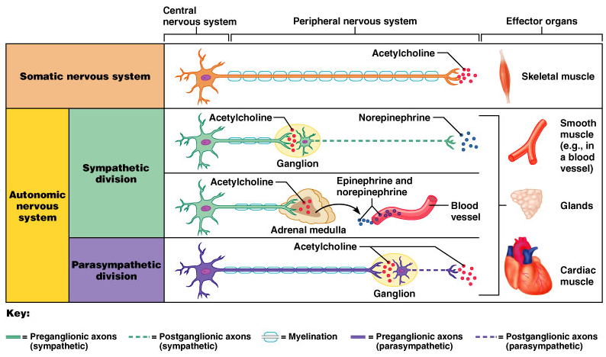
PNS Motor Neurons, synapses and neurotransmitters
Learning Aim: Describe the synapses and neurotransmitters involved in the different parts of the motor division of the PNS

Slide 15
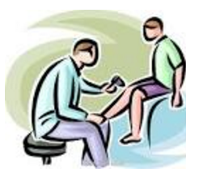
Reflexes
Ch4 HP: The nervous system is highly organised

Slide 16
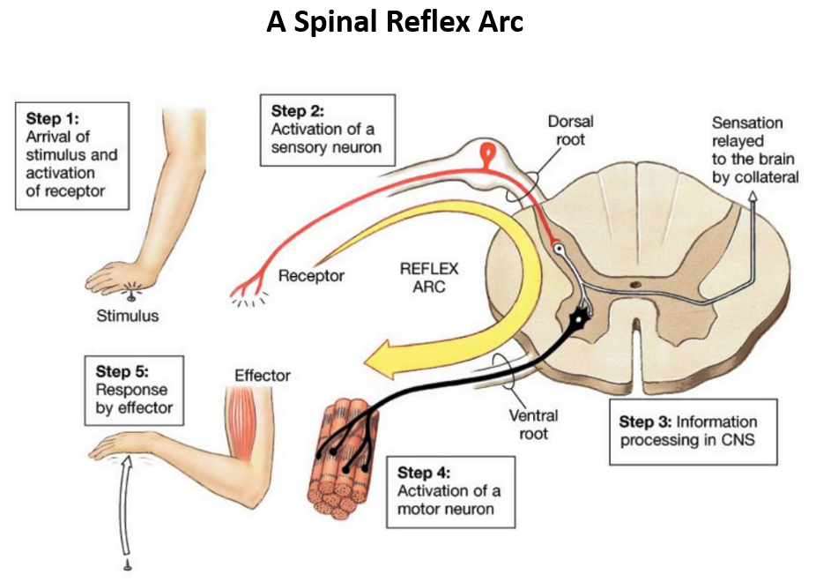
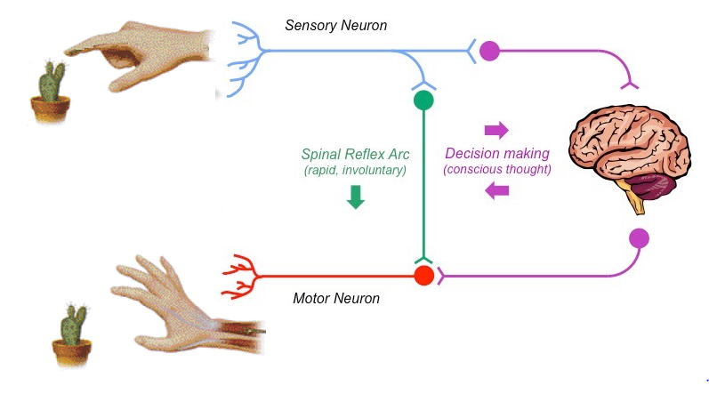
Reflexes
Rapid, involuntary response to change.
4 properties:
Stimulus required
Involuntary
Rapid
Stereotyped (occurs same way each time)
May involve:
Unconscious parts of the brain (sometimes)
Spinal Cord (usually)
Function to
Protect body from injury
Maintain homeostasis
Learning Aim: Define reflexes and list the four properties of reflexes

Slide 17
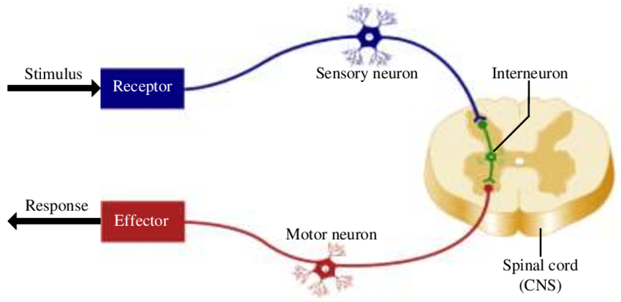
Components of a Reflex Arc
Receptor:
Provides stimulus, eg
Pain
Change in homeostatic balance
Control Centre
Brain
Spinal Cord
Effector:
Tissue/organ/system that responds eg:
Skeletal muscle
Smooth muscle
Gland
Has the following components:
A receptor
End of sensory neuron, or a specialised cell that transmits to a sensory neuron
A Sensory neuron
Carries impulses to CNS
At least one synapse
Sensory neuron → interneurons → Motor Neuron
Sensory neuron →Motor Neuron
A Motor neuron
Carries impulse to effector
An Effector
Carries out response.
Muscle or secretory cells.
Learning Aim: describe the components of a reflex arc

Slide 18
Innate vs Acquired Reflexes
Innate reflexes
Present from birth and/or appear during development
Automatic, not learned
Eg: blink reflex, patellar reflex
Acquired reflexes
Complex motor patterns
Learned through repetition
Eg: balancing on a bike, jamming on brakes, catching a ball.
Learning Aim: explain the difference between innate and acquired reflexes

Slide 19
Some common reflexes
Blink reflex – when someone pokes your eye
Patellar reflex – knee jerk when hit with hammer
Saliva secretion after smelling food
Sneezing and coughing due to irritation
Autonomic nervous system responses (eg fight/flight)
Constriction of pupil after exposure to light
Learning Aim: list some common reflexes

